Slide 1
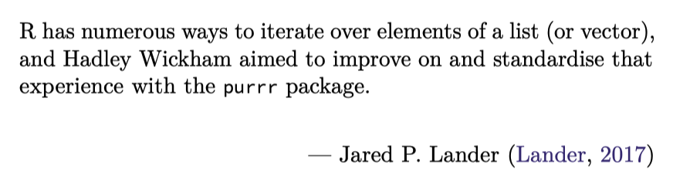
Data Science for Operational Researchers using R
08 – purrr
https://github.com/JimDuggan/explore_or

Slide 2
Overview
We earlier used the functional lapply() to iterate over an atomic vector, list, or data frame.
The tidyverse package purrr provides a comprehensive set of functions that can be used to iterate over data structures
It also integrates with other elements of the tidyverse, for example, the package dplyr.
Topics
map() family of functions
Integtating with dplyr to process tibble
Mini-case with linear models.

Slide 3
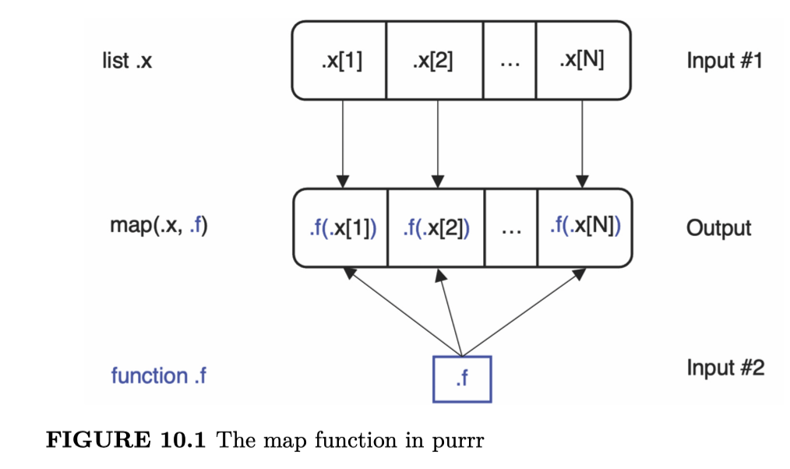
(1) The map() family of functions
The idea of the map() function is to provide a mechanism to iterate over an input list or a vector.
It applies a function to each input element, and returns the result within a list that is exactly the same length as the input.
We call these functions functionals, as they accept a function as an argument, and use that function in order to generate the output

Slide 4
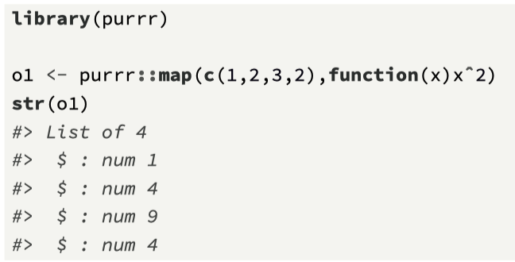
General format of map(.x, .f)
.x is a list, or an atomic vector.
If .x has named elements, the return value will preserve those names.
.f can be a function, formula, or vector.

Slide 5
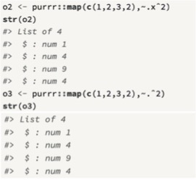
Using a formula
A formula (which is defined by ~) can be used as a function argument, and it is essentially a function shortcut in purrr, and commonly used in map()
~ marks the start of the function, and .x as the function parameter, where . can also be used to represent the function parameter.

Slide 6
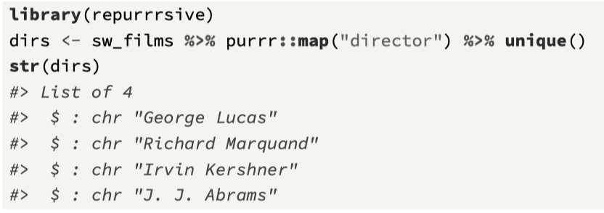
Using map() to select a list element
map() functions can be used to select a list element by name, and these are beneficial when working with lists that are deeply nested (Wickham, 2019).

Slide 7
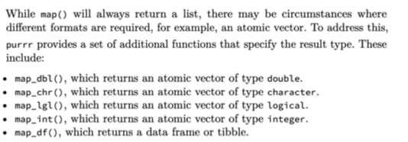
Additional map_* functions

Slide 8
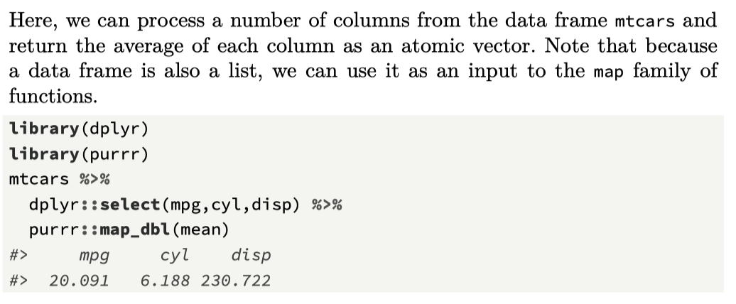
map_dbl()

Slide 9
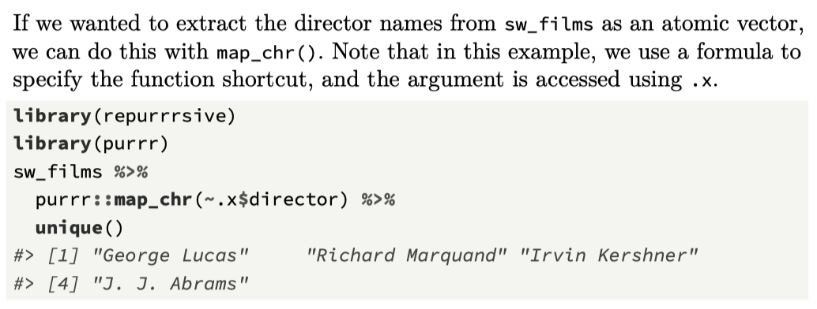
map_chr()

Slide 10
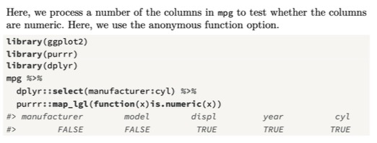
map_lgl()

Slide 11
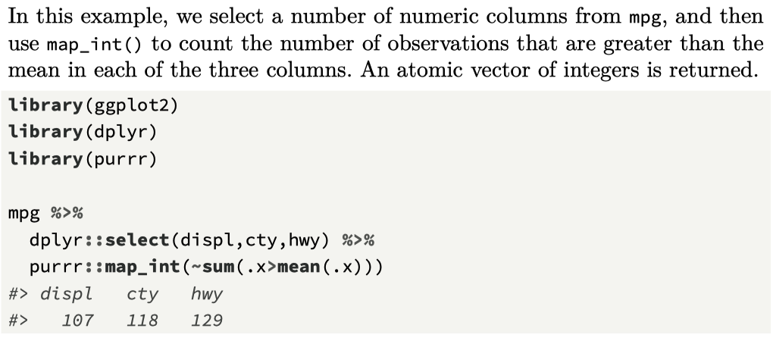
map_int()

Slide 12
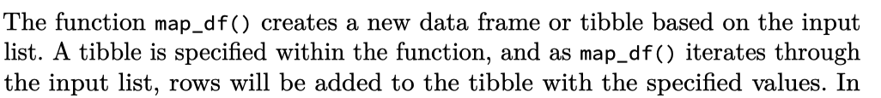
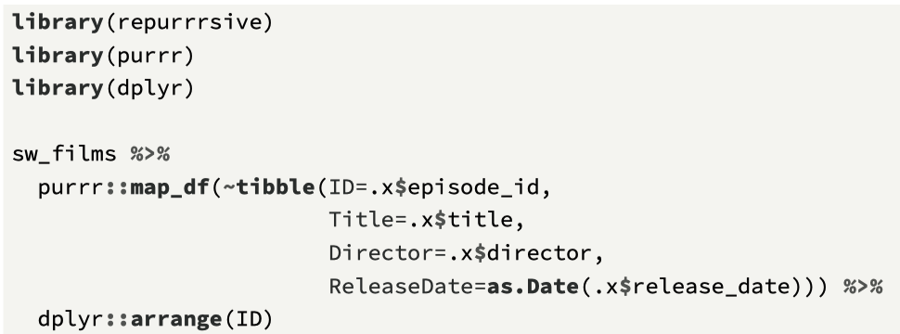
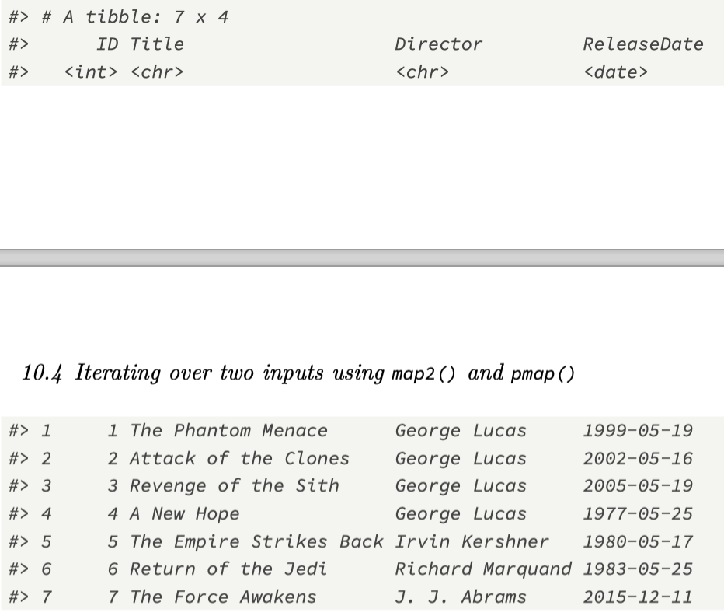
map_df()

Slide 13
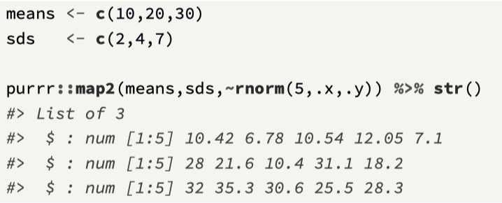
Iterating over 2 inputs – map2()
The function map2() allows for two inputs, and these are then represented as arguments by .x and .y.

Slide 14
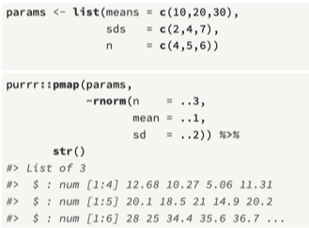
Iterating over multiple inputs with pmap()
pmap() can take a list containing any number of arguments, and process these elements within the function using the symbols ..1, ..2 which represent the first, second, and additional arguments

Slide 15
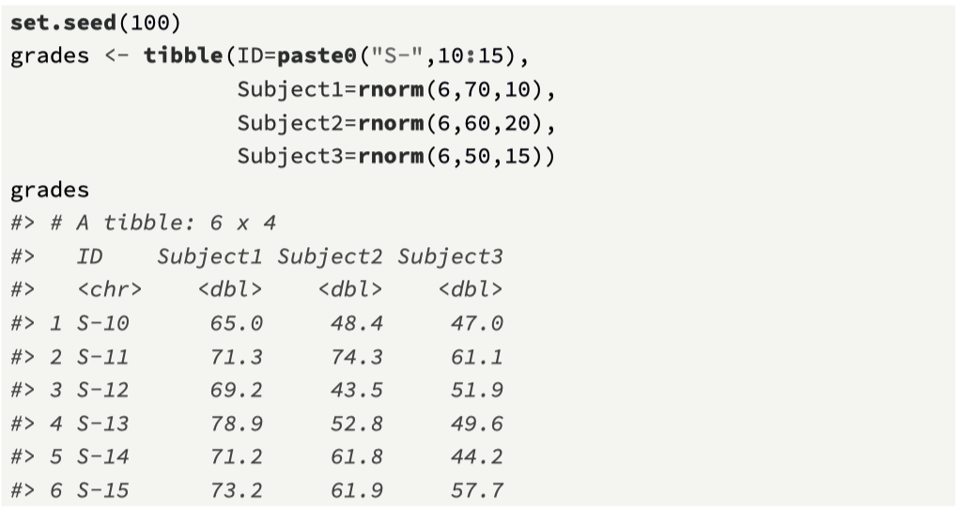
pmap() example

Slide 16
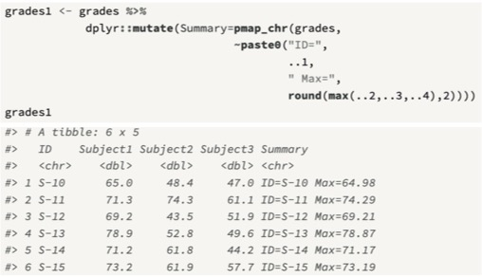
pmap() example 2

Slide 17
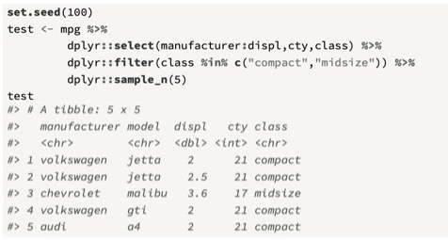
2. Integrating purrr with dplyr and tidyr
A benefit of using the tidyverse is having the facility to combine tools from different packages, and switching between the use of lists and tibbles where appropriate.
A common task is to divide a tibble into sub-groups, and perform operations on these
We first define a test data set

Slide 18
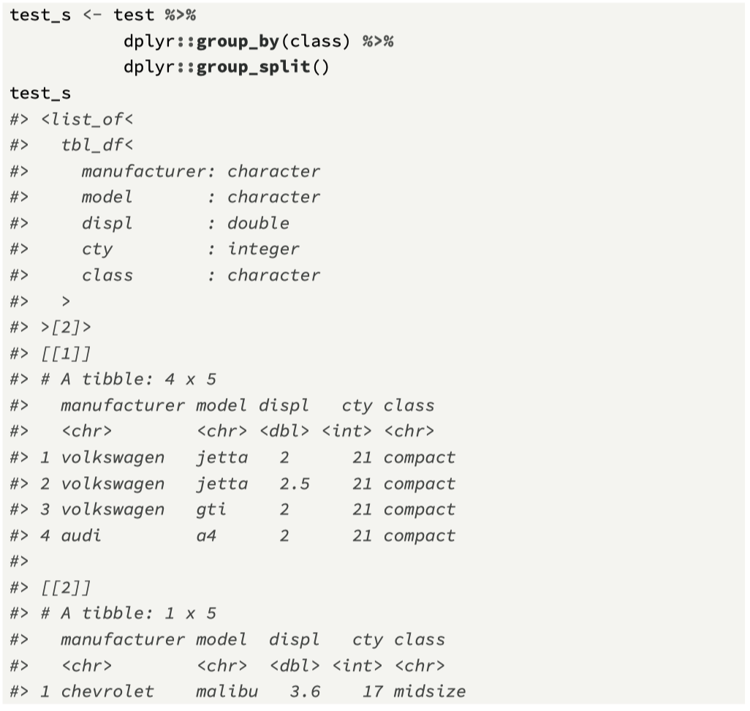
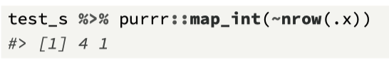
group_split()
Takes a tibble
And grouping variable(s)
Generates a list of tibbles

Slide 19
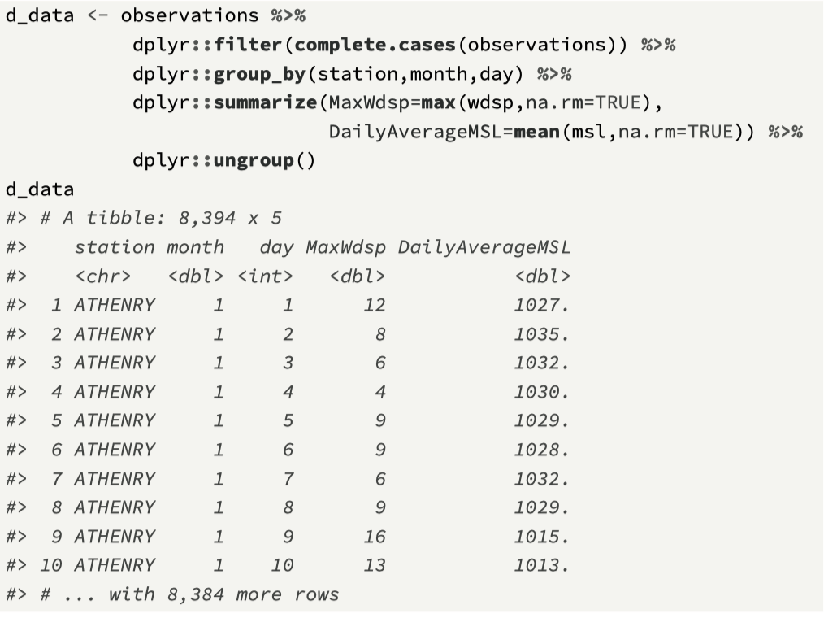
Exploring data
Our goal is to calculate the correlation coefficient between two variables at each station: mean sea level pressure and average wind speed.
We simplify the dataset to daily values, where we take (1) the maximum wind speed (wdsp) recorded and (2) the average mean sea level pressure (msl).
Our first task is to use dplyr to generate a summary tibble, and we also exclude any cases that have missing values, by combining complete.cases() within filter

Slide 20
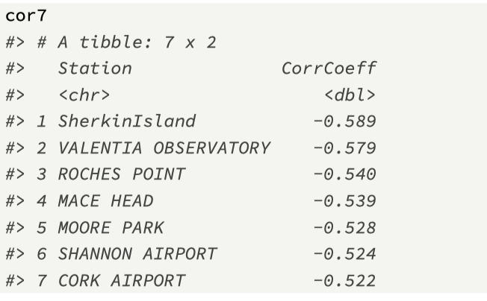
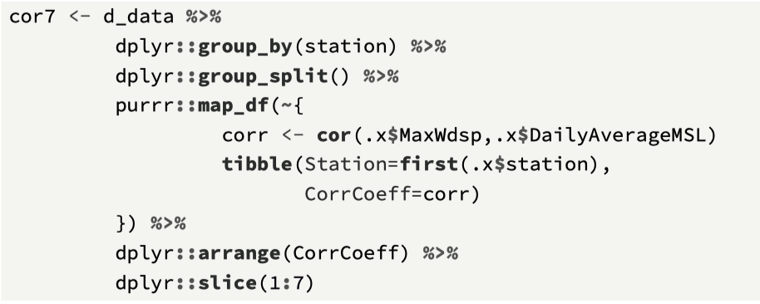
Process the results

Slide 21
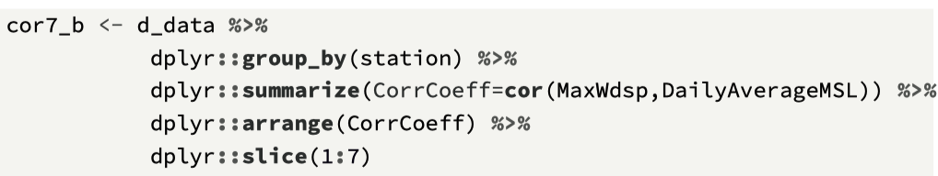
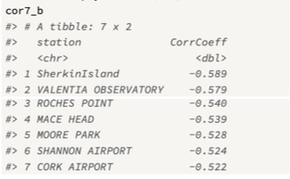
Alternative solution…

Slide 22
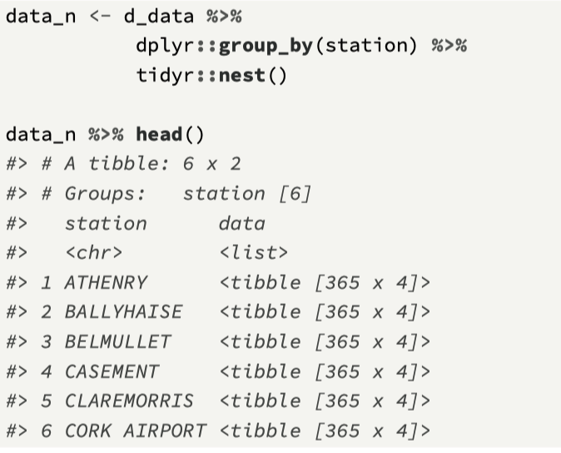
nest()
nest(), which is part of the package tidyr, can be used to create a list column within a tibble that contains a data frame.
Nesting generates one row for each defined group, which is identified using the function group_by().
The second column is named data, and is a list, and each list element contains all of the tibble’s data for a particular group.

Slide 23
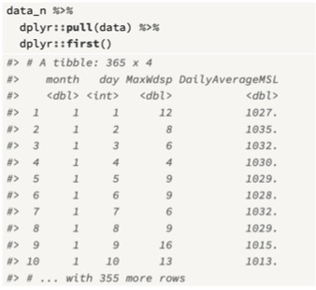
The data column
Here, the tibble data_n contains two columns, with a row for each weather station (the first six rows are shown here).
All of the data for each weather station is stored in the respective cell in the column data.
first() is a wrapper around the list operator [[ that returns the first value in a list.
Note the group name does not appear in data (it is already in the first column)

Slide 24
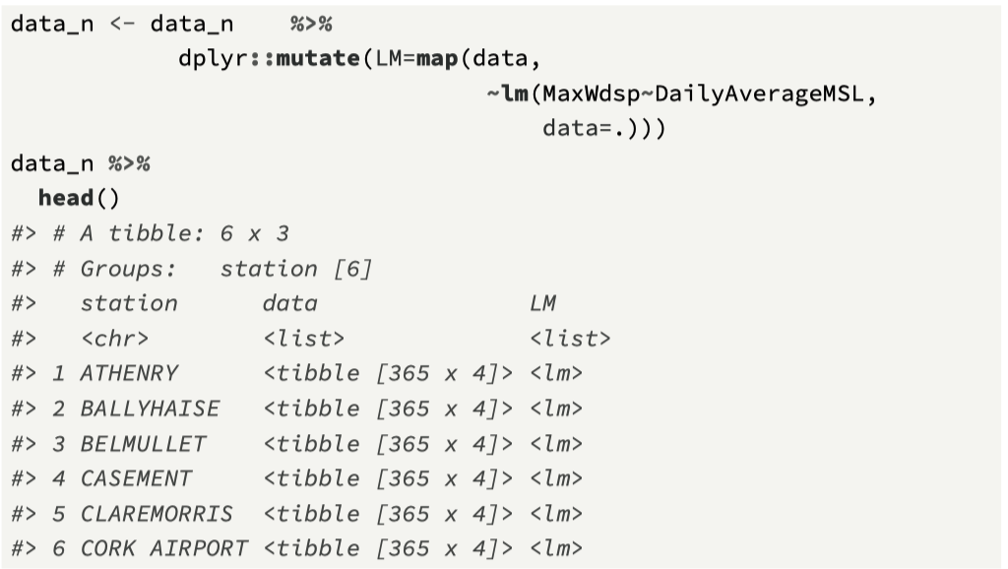
Generating a linear model for each row using map()

Slide 25
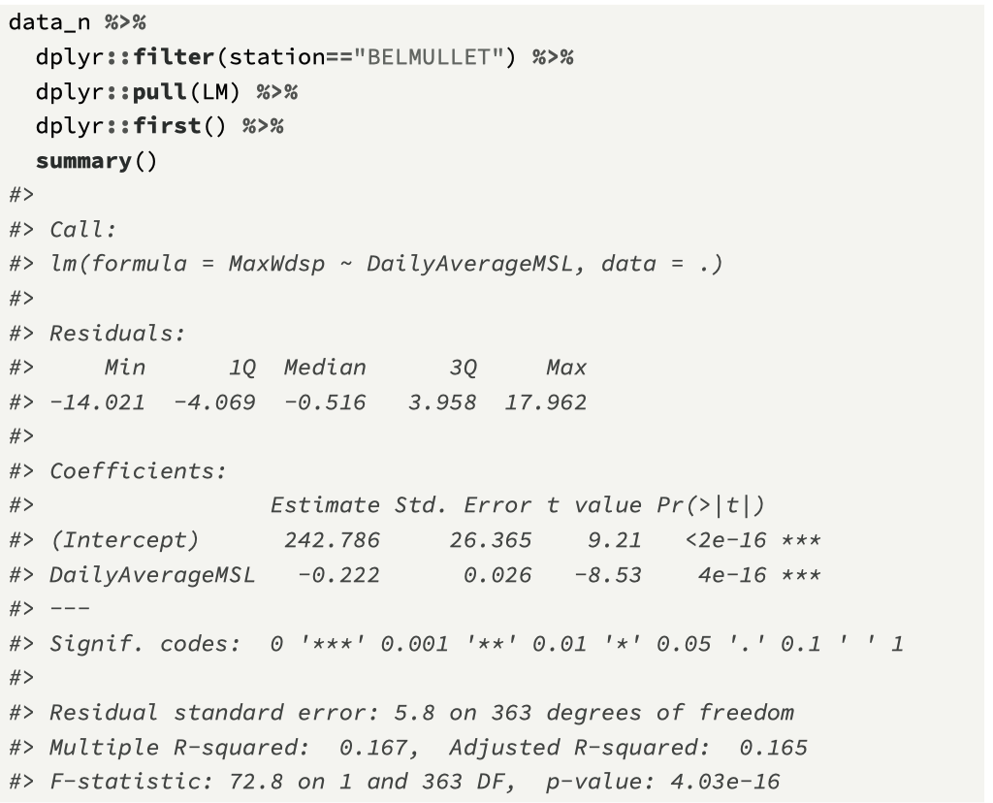
Exploring the result for “BELMULLET”
Note, probably not needed…

Slide 26
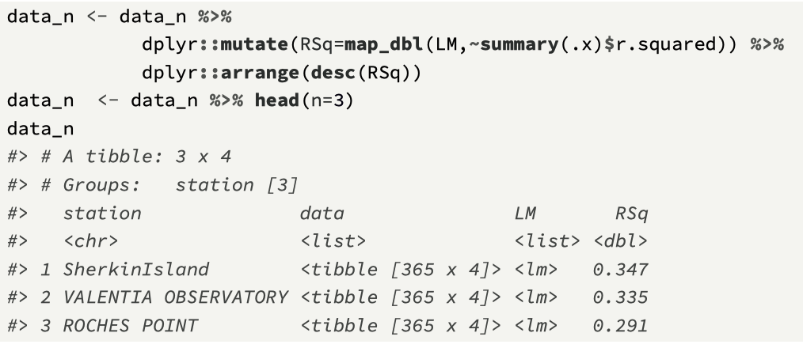
Add R² value as a column

Slide 27
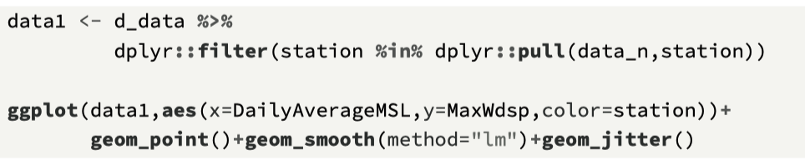
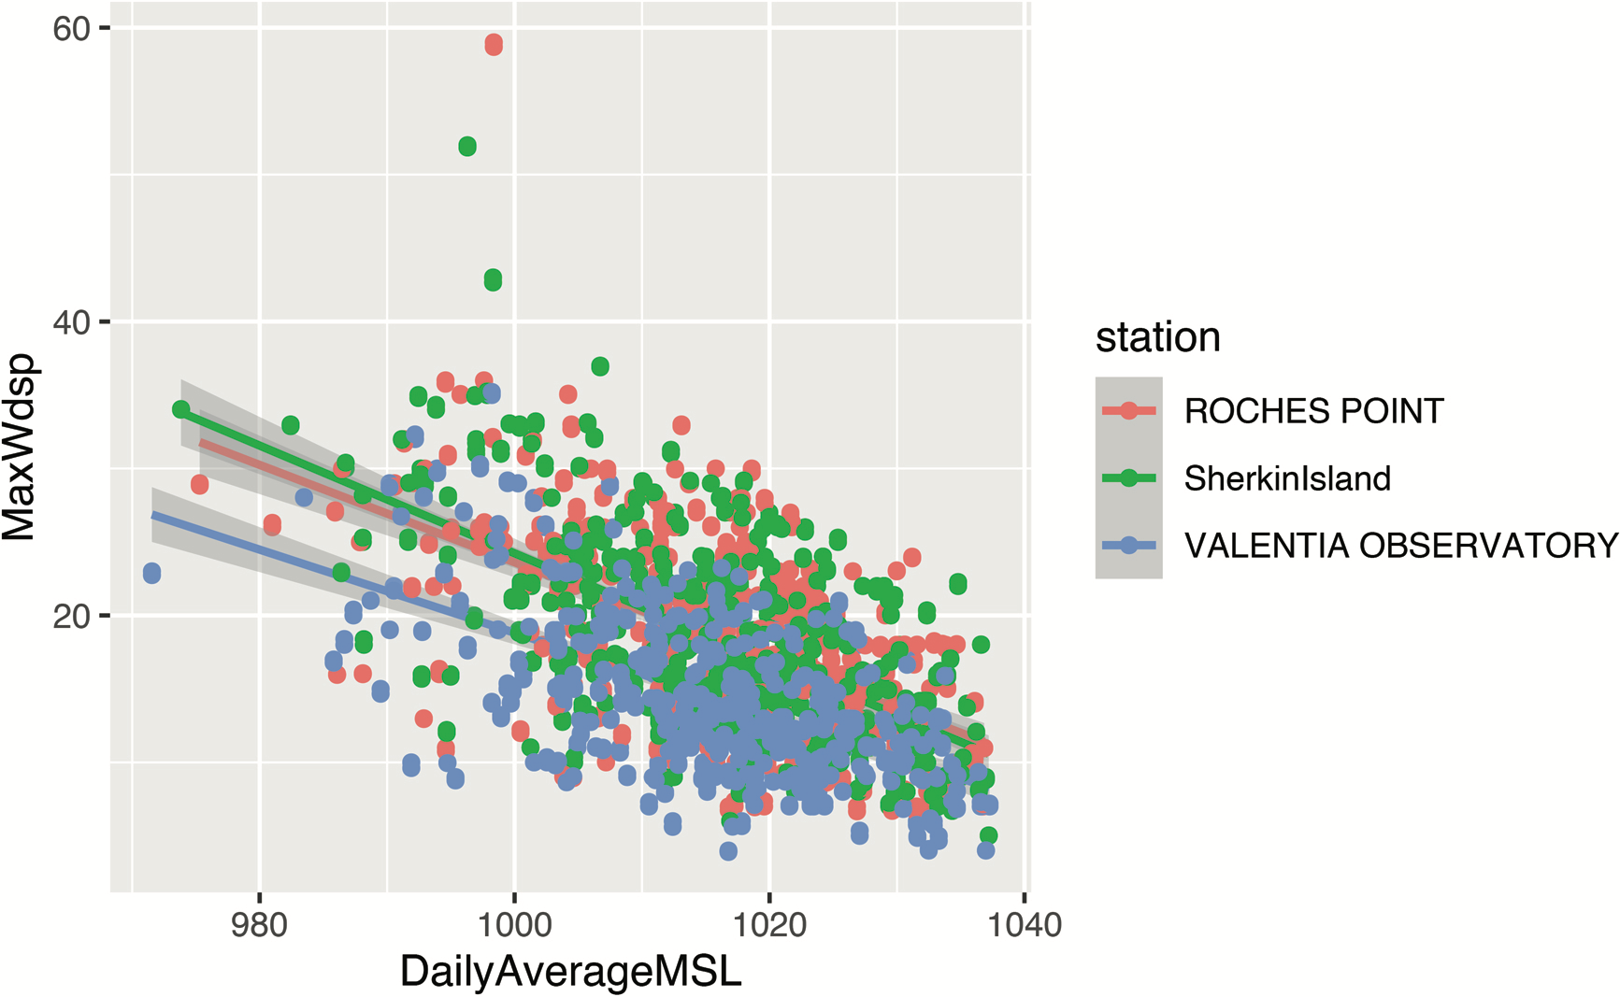

Slide 28
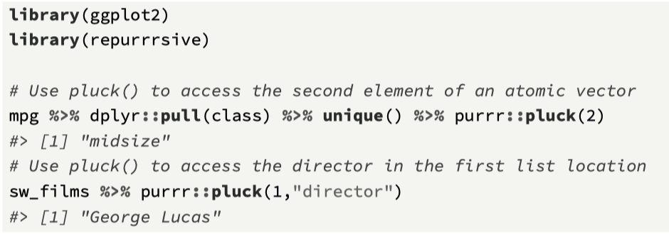
pluck()
The function pluck() provides a generalized form of the [[ operator and provides the means to index data structures in a flexible way.
The arguments include .x, which is a vector, and a list of accessors for indexing into the object, which can include an integer position or a string name.

Slide 29
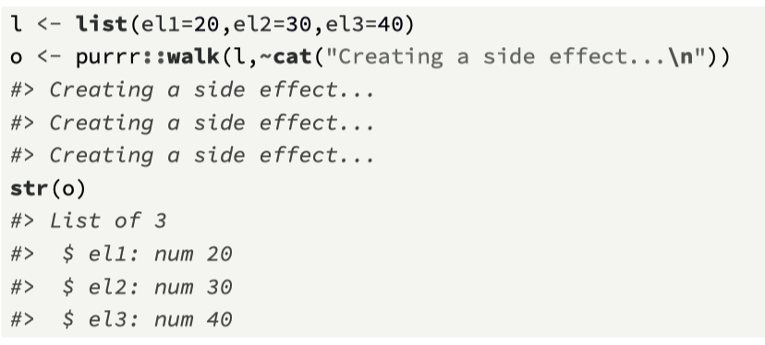
walk()
walk(.x,.f) is similar to map, except that it returns the input .x and calls the function .f to generate a side effect.
The side effect, for example, could be displaying information onto the screen.

Slide 30
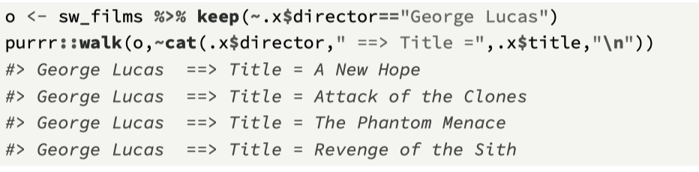
keep()
The function keep(.x,.f) takes in a list .x and, based on the evaluation of a predicate function, will either keep or discard list element.
In effect, it provides a way to filter a list.

Slide 31
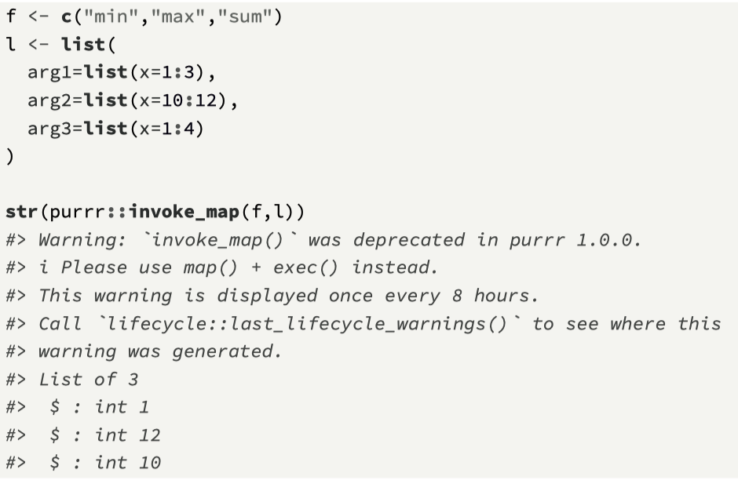
invoke_map()
Provides a feature to call a list of functions with a list of parameters.
It is a wrapper around the R function do.call().
The function takes a list of functions (where the function names are contained in a character vector), and an argument list, where the names of the function arguments are contained in the list.
Function is now deprecated (see advice)

Slide 32
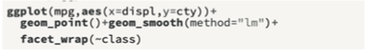
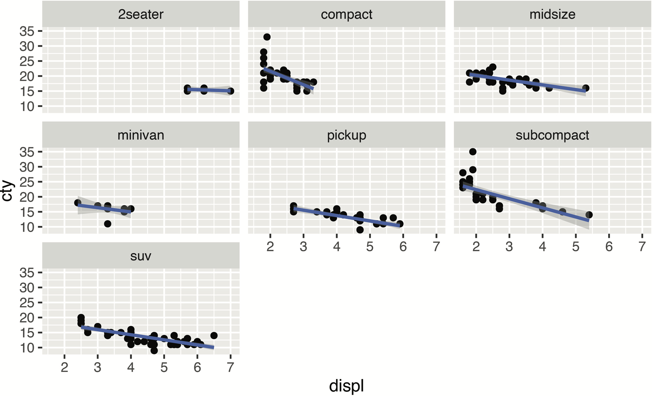
Mini-case - Linear models
Here, we generate a collection of linear models from the mpg tibble, and explore the relationship between a dependent variable (cty) and a dependent variable (displ).
In this example, we will partition the data by vehicle class, and so build seven different linear models.
Before starting the modelling workflow, we can visualize the different linear models using ggplot().

Slide 33
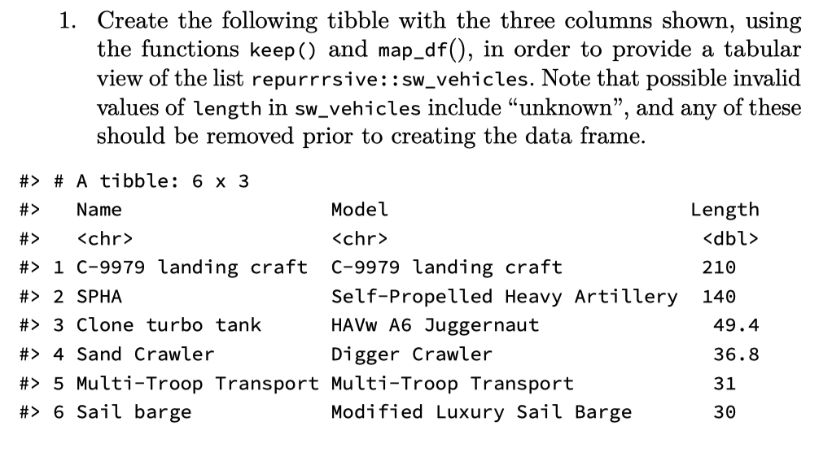
Exercise 1

Slide 34
Overall approach
Create a nested tibble (grouped by class), and this will have two columns, class and data, where the data column is created by the call to nest().
Using mutate(), add a new column that will store the results of each linear model.
Process the linear model results to extract a measure of model performance (r-squared) to see how well each regression model explains observed data.
Arrange the tibble so that the best model scores are shown first.
Add a column that will store the plots for each model.

Slide 35
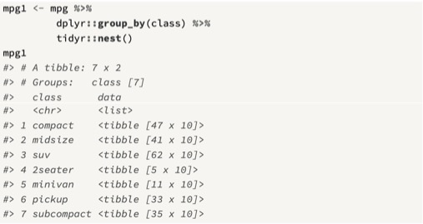
Use nest() to reconfigure tibble

Slide 36
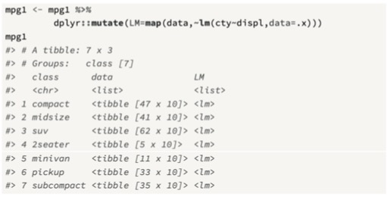
Perform regression on each vehicle class

Slide 37
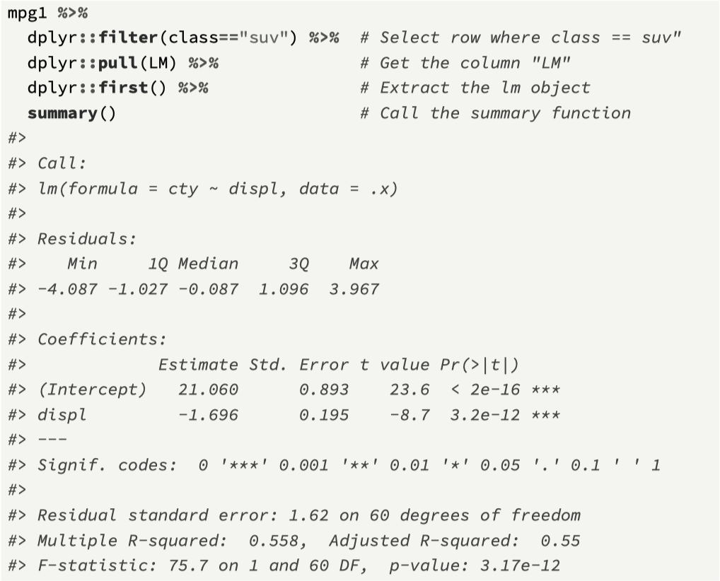
Show one of the model results

Slide 38
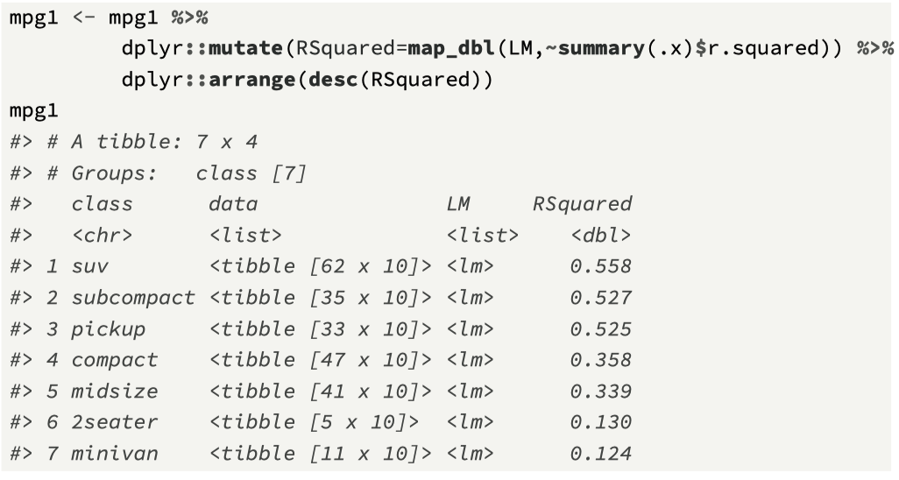
Extract R² value into new column

Slide 39
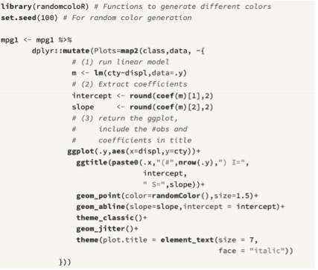
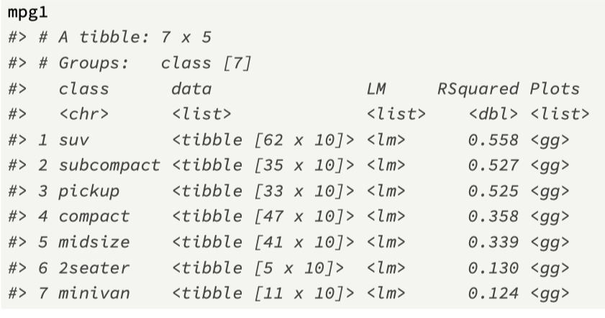
Create custom plots via map2()

Slide 40
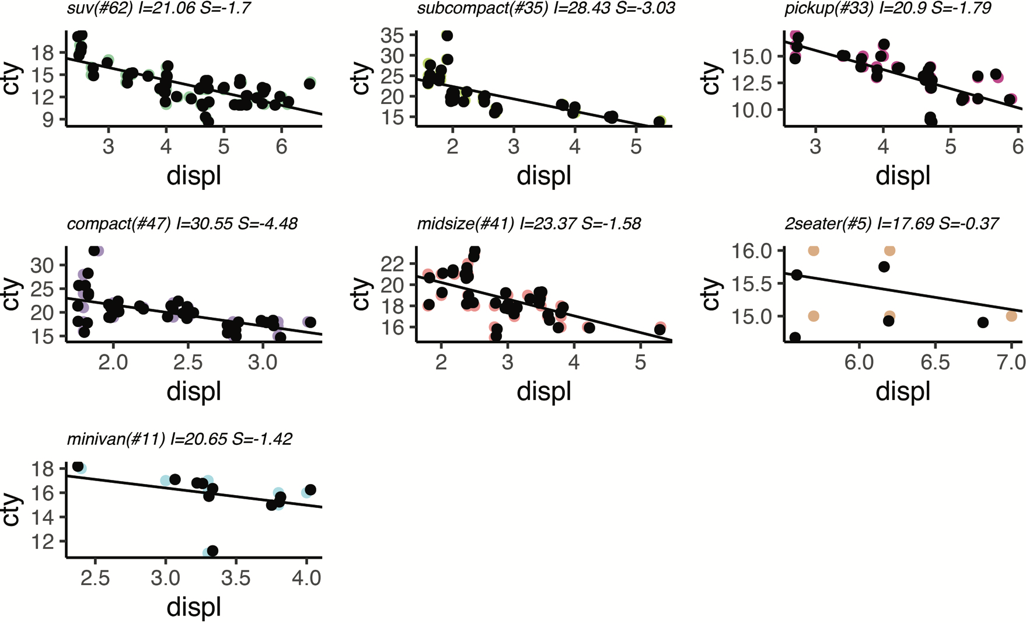
Visualise results (package ggpubr)

